Slide 1
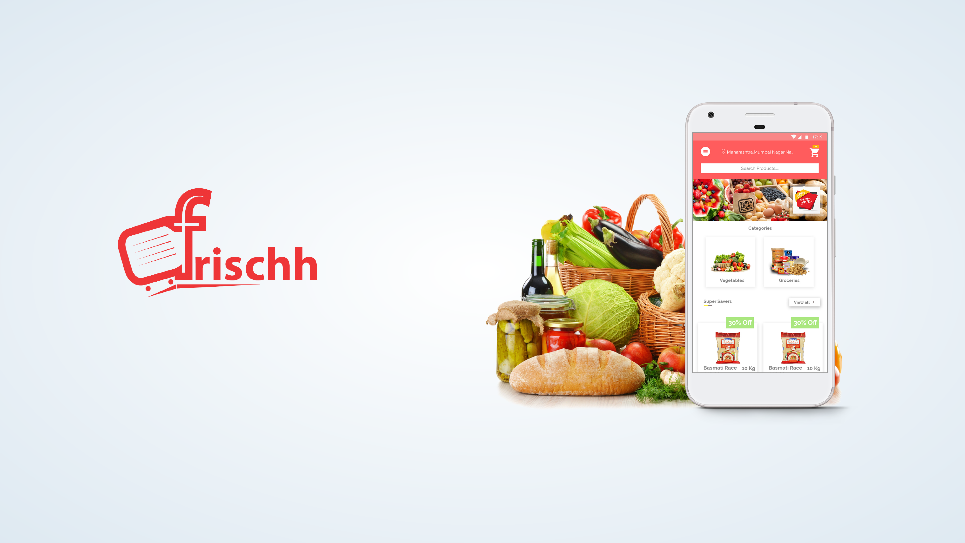
Your Pay-a-you-go friend for grocery needs.

Slide 2

Problem
Access to fresh grocery is a daily or weekly hassle, made of round trips across
multiple local stores and long waiting queues.
A non-transparent market prevents consumers from easily comparing prices,
products and availability across multiple local stores at a single glance.
No smart financial advisor exist to optimise your grocery expenses and
consumers cannot know the local store promotions or offers unless they visit.

Slide 3
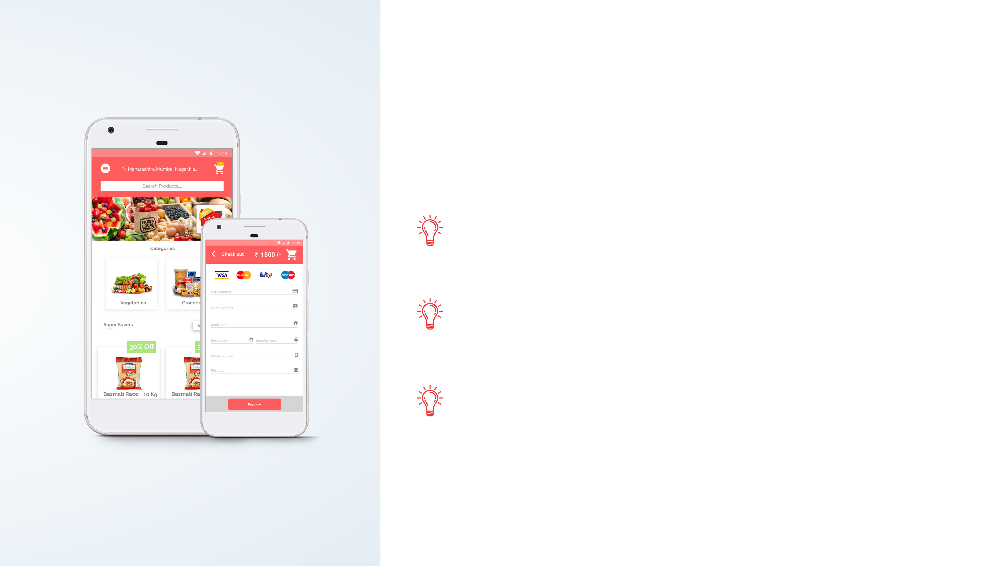
Introducing Frischh
A mobile platform which brings your favorite local grocery retail
stores to your doorsteps on a Pay-as-you-go subscription
model.
A single window access to all your favourite local stores which
helps you save money and time spent on weekly grocery
shopping.
Keep yourself informed about local promotions and optimise
your grocery expenses based on intelligent expense
optimisation advices.

Slide 4

Key Features
Explore - Explore multiple stores and setup your Frischh
baskets with your favourite grocery items.
Subscribe - Subscribe to your Frischh baskets with a flexible
daily, weekly or monthly delivery frequencies.
Pay-as-you-go - Setup your Frischh wallet with the preferred
payment method or top-up your wallet from bank account to
pay your grocery bills monthly.
Pause - Pause, edit or cancel your Frischh basket
subscriptions anytime you want, and your payment and
subsequent delivery stops exactly at the same moment.
Optimize - Analyse your consumption every month and optimise your grocery
expenses by adopting promotion advices for your local stores.

Slide 5
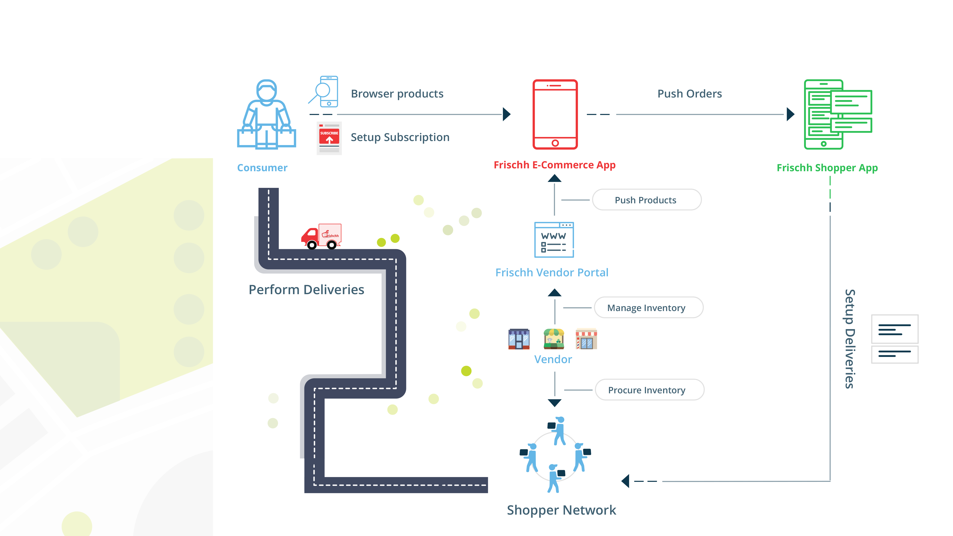
How it works

Slide 6
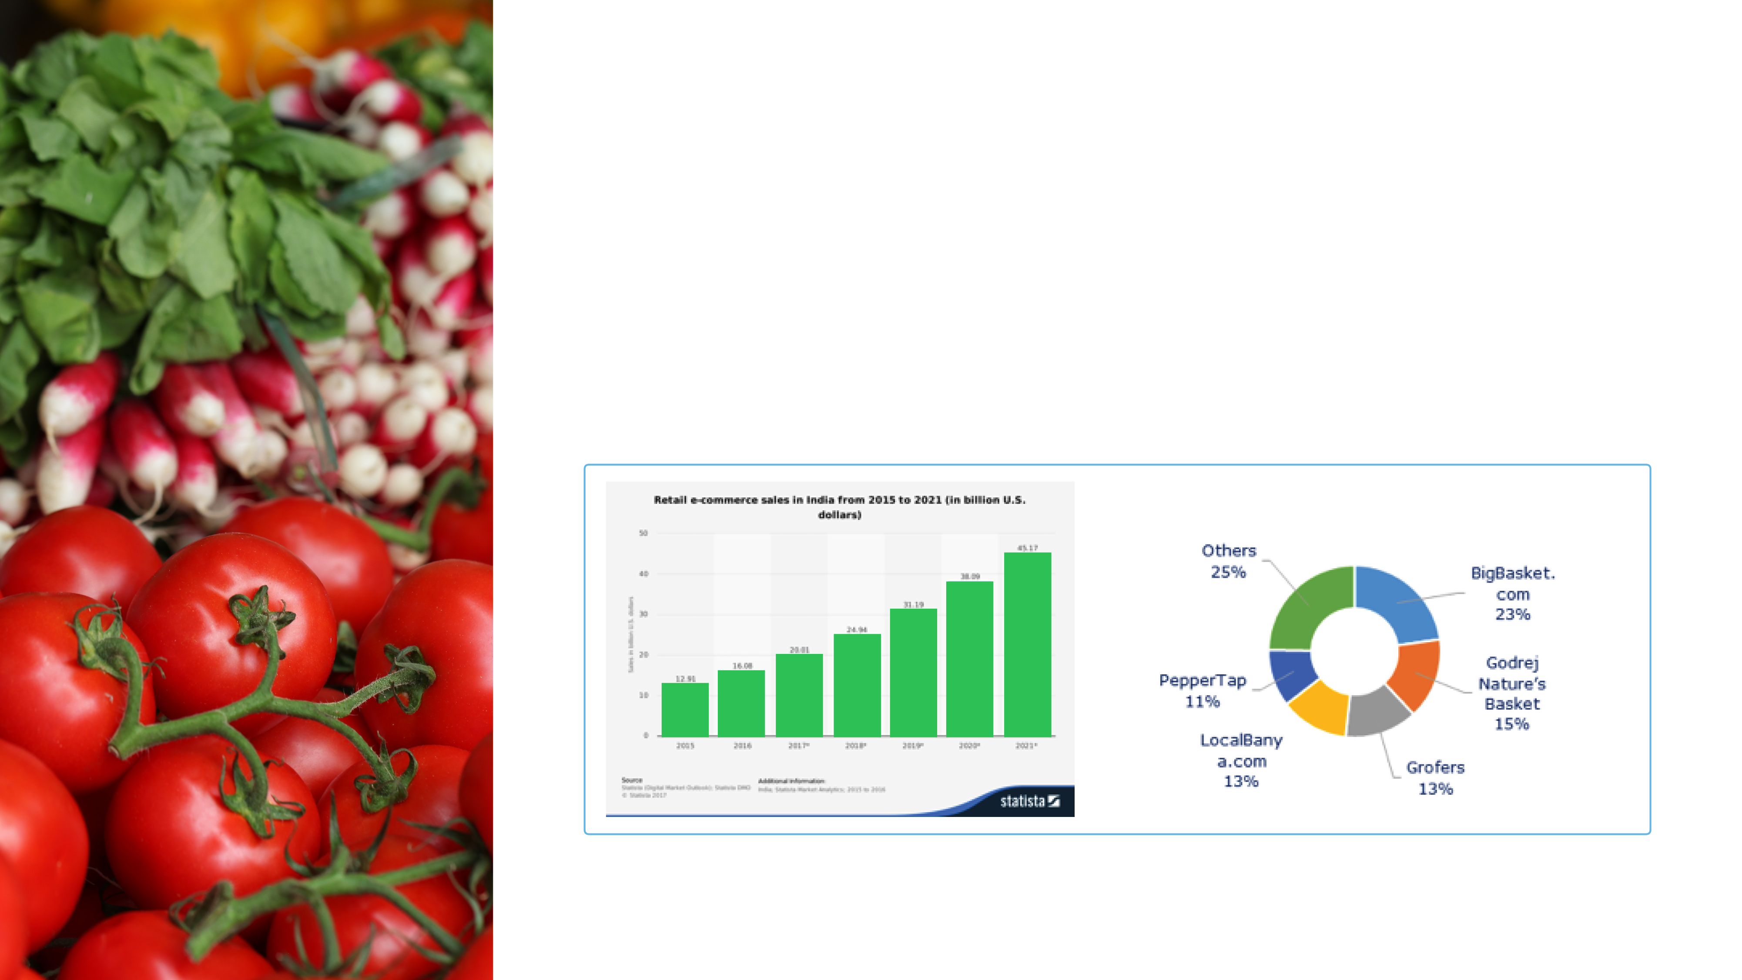
Market
The online E-Grocery delivery market is estimated to be around $600 million in
India and is pegged to touch $5 billion by 2020 at a CAGR of 72%. Frischh is
targeting Cochin, Kerala as the target city to initiate its operations.

Slide 7

Competitive Advantage
Strong foundation for pay-as-you-go subscription model
to market.
Insightful analytics to understand your grocery expense.
A single window multi-vendor approach giving choice to
consumers.

Slide 8

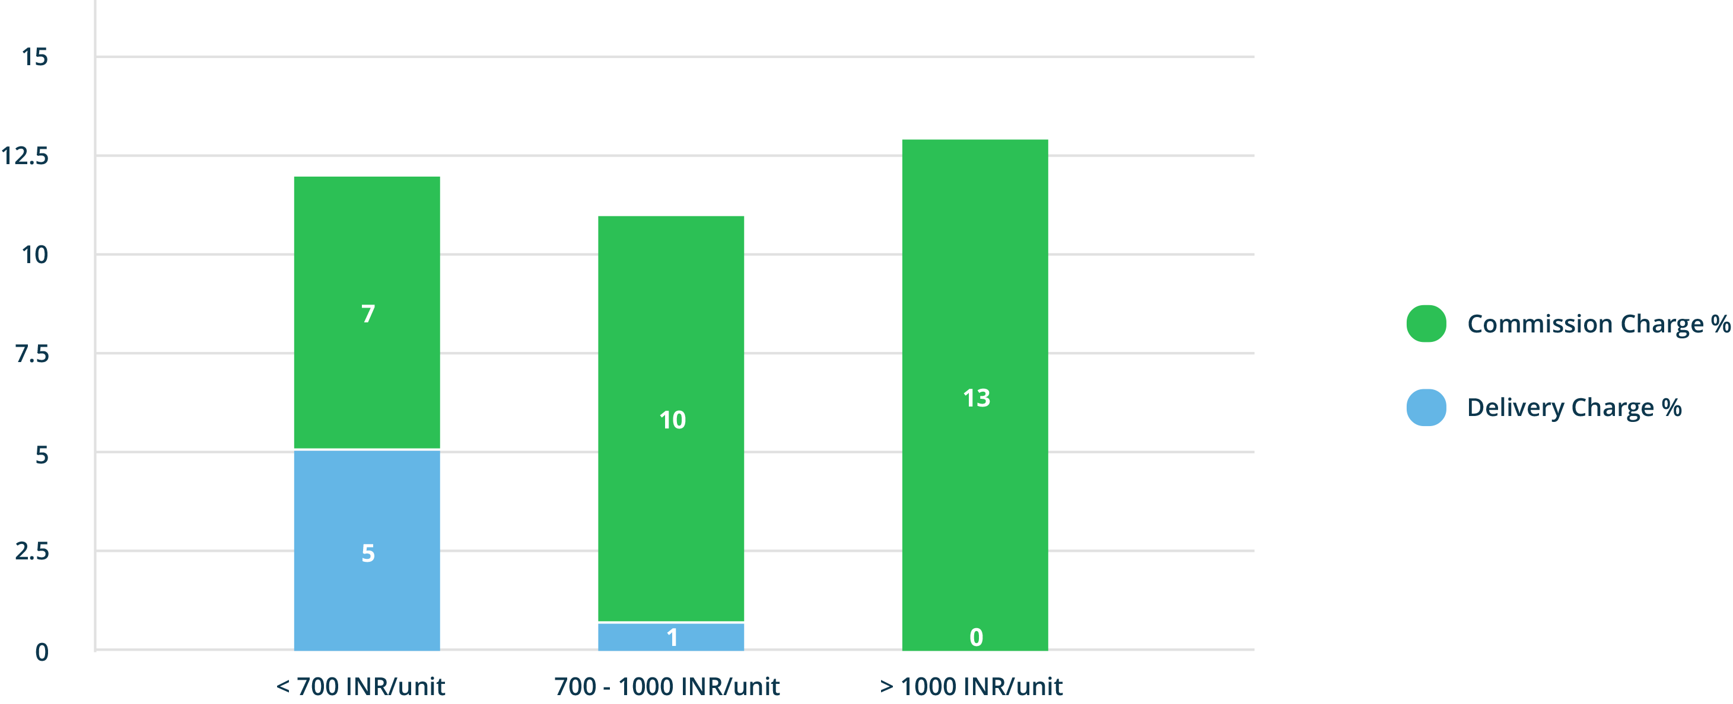
Business Model
Frischh uses Hyper Local revenue share business model powered by logistics of shopper network.

Slide 9

Market Penetration
Hyperlocal marketing - Frischh field staff will visit the consumer premises to educate them about
the benefits of the platform thereby taking offline orders.
Kirana Partnerships - Frischh sales team will consistently work towards building an ever growing
partnership base of kirana stores and retail vendors on a per target city basis.
Network Effect - Frischh will actively conduct promotion events to build a huge shopper network
locally by encouraging youngsters to do part time job.

Slide 10

Team
Kannan Reghu
Founder
Kannan comes onboard with 9 years of experience crafting high performance consumer and enterprise
applications on web, mobile and cloud ecosystem. Proven track record in building technology startups and
frontline leadership in mission critical commercial launches in Singapore and Europe. Key contributions to
healthcare, retail, internet of things, real estate, education, e-commerce, telecom and entertainment
industries. Proven track record of playing key role in C-Level to launch 3 technology startups in consulting,
telecom and e-commerce industries helping them to achieve seed to series A potential. He is contributing to
Frischh with core expertise in business development, strategic planning and technology architectures.
Ramachandran Nair
Co-Founder
Ramachandran is a web engineering geek with 8 years of industry experiencing in building web applications
across multiple domains. He comes from very strong entrepreneur and operations background leading
multiple teams in the consulting space of India. He has played key roles in developing backend systems for
world class projects including https://www.tizen.org/. He is contributing to Frischh in terms of team building
and operations management for sales, marketing and shopper network management.

Slide 11
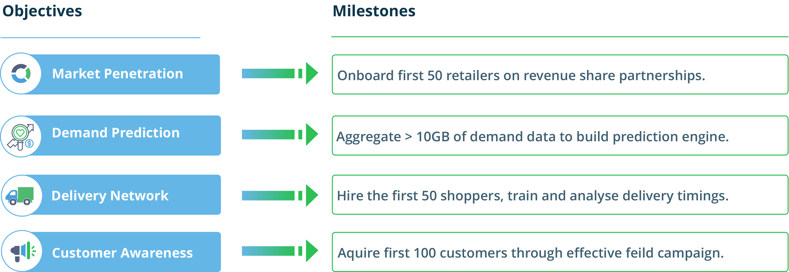
Funding
We are looking for a 12 months bootstrap funding of 80K USD for an equity of 7% for a pre-money valuation of
300K USD.

Slide 12

Contact Us
For any queries and inquiry, please send us a note at
support@frischh.com

